Slide 1
Retirement Playhouse

Slide 2
Core Visual
100%
CONFIDENCE
LEVEL
0%
NET
CONTRIBUTION
?
?
10
RISK
0
Age Today
Semi-Retirement
Retirement
Preserve
Capital
Life
Expectancy

Slide 3
Core Visual Explanation
Previous slide is intended to illustrate how all the parameters of the program fit together
It is NOT a suggestion for a UI implementation “as is”
  However, one idea is to break it down in 3-4 screens - e.g. in a wizard

Slide 4
3 Types of Parameters
Phases of life: working, retirement, …
  Phases of life are determined by ages: today, retirement, life expectancy,…
Contribution/withdrawal amounts during phases of life
Portfolio risk for each phase of life

Slide 5
2 modes
  Set confidence level -> compute withdrawal during retirement
  Set withdrawal during retirement -> compute confidence level that this is achievable

Slide 6
Risk Based Asset Allocation
We offer a simple way to allocate assets:
  User picks a number between 0 and 10, and we perform asset allocation based on the table below
  Higher the risk, the more stocks. Lower the risk more Cash
Risk | Stocks | Bonds | T-Bills | Cash
0 | 0% | 0% | 0% | 100%
1 | 0% | 0% | 50% | 50%
2 | 0% | 20% | 70% | 10%
3 | 0% | 40% | 60% | 0%
4 | 20% | 40% | 40% | 0%
5 | 50% | 35% | 15% | 0%
6 | 60% | 30% | 10% | 0%
7 | 70% | 20% | 10% | 0%
8 | 80% | 20% | 0% | 0%
9 | 90% | 10% | 0% | 0%
10 | 100% | 0% | 0% | 0%

Slide 7
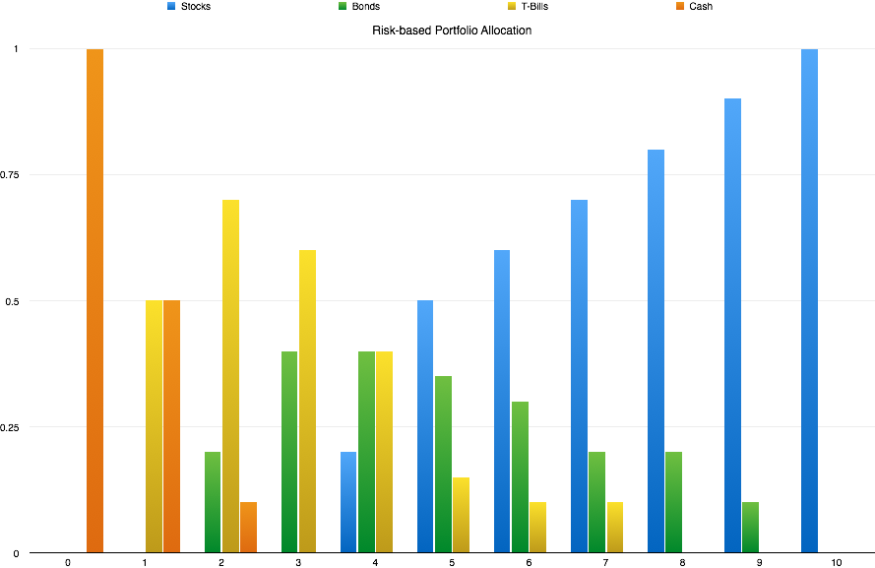
Risk Based Asset Allocation

Slide 8
UI Flow
“Constants”: age today, username, email, starting $$ amount, inflation rate…
  Immediately generate default ages, contributions and risk levels -> Withdrawal amount
  ? Allow user to select which of the next 4 steps to do next ?
Define phases
Define contributions/withdrawals per phase
Set portfolio risks
Select mode
Present interactive UI where user can change parameters and see corresponding results
  May require different modes of the UI, depending on which parameters the user wants to adjust (ages, amounts, risk)
  User option to save each scenario/result
Advanced mode where portfolio allocations can be adjusted
  Risk -> portfolio
  Specific asset allocation for each phase
  Statistical values for asset types
  Custom asset types

Slide 9
Interactivity
In order to have reasonable accuracy, the MonteCarlo simulations should be run 10,000 or more times
An acceptable response times for user only allows 1,000 simulations (to be confirmed)
Ideally, the program will provide an immediate answer after 1,000 simulations, and then continue to refine (e.g. every 1,000) as more runs complete.
  UI should have an indicator for the level of completion of the MC runs
  Total number of simulations to be computed should be a (advanced) setting of the app

Slide 10
Evolution of the Experience
When the user starts, we capture the absolute minimum number of parameters so that we can provide a $number for withdrawal
Once we have that number, we present it along with a visual that depicts our assumptions - e.g. something like slide 2
There, we offer 2 paths
  Modify each parameter 1 by 1
  Use the wizard to configure everything step-by-step
Menu should allow the user to access types of parameters directly (phases, contributions, risk)
At any point, the user must see both
  Visual representation of all assumptions
  $Withdrawal & confidence level

Slide 11
More Stuff
We should have a graph of “Capital $” over time
Inflation rate needs to be adjustable - can we fit it on the main view?
Need a Settings menu
  Individual settings: e.g. Number of MonteCarlo runs, default confidence level, etc
  Statistical parameters: risk -> asset allocation, stats for asset classes, custom asset types

